Slide 1
Project -1 = Python Based Calculator
Presented by : Ashvini Satish Jagtap.

Slide 2
Contents
Project Objective
Introdution
Flow Chart Of Calculator Working Model
What I learn?
Software Requirements
Future Enhancement
Reference

Slide 3
Project Objective
To develop an simple calculator using Python
which provides
Simple arithmetic operation.
The operation performed are
Addition
Subtraction
Multiplication
Division
Clearing the content of the screen.

Slide 4
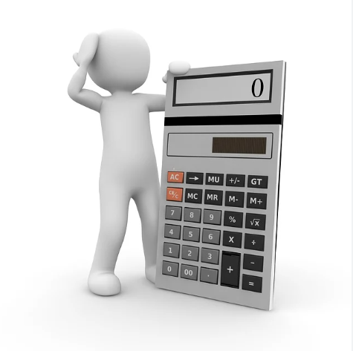
Introduction
A Calculator is small,portable,often inexpensive electonic device that is used to perform both basic and complex operation arithmetic.

Slide 5
Flowchart of Calculator
→
→
→
Run & Debug
→
VS Code
Installtion
Calculator
layout
Coding
Calculator
popup
What I Learnt ?
Technical learning
Python programmimg
General Learning
How design & Implement coding skills.
How to add features.
Software Requirements
1.Visual Studio Code.
2.Jupyter Notebook.

Slide 6
Future enhancement 1. Designing my own calculator. 2. Make this calculator more interactive and may use deep learning and AI so that I can text to speech the numbers.
Reference
https://www.google.co.in
https://www.geeksforgeeks.org/python-simple-gui-calculator-using-tkinter
https://www.youtube.com
https://github.com

Slide 7
THANK YOU

